Slide 1
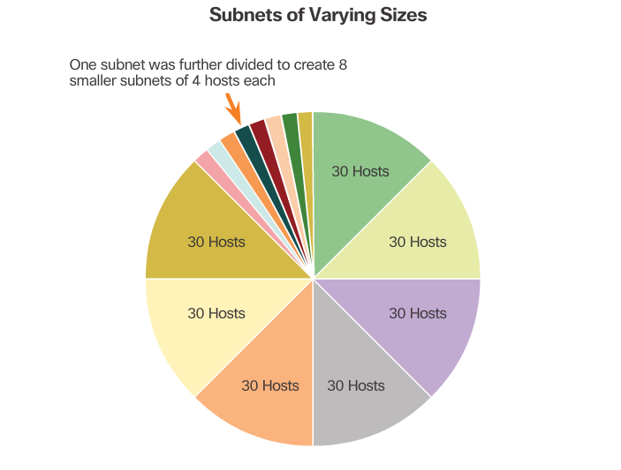
Variable Length Subnet Masks
Notes:
8.1.5.2 Variable Length Subnet Masks

Slide 2
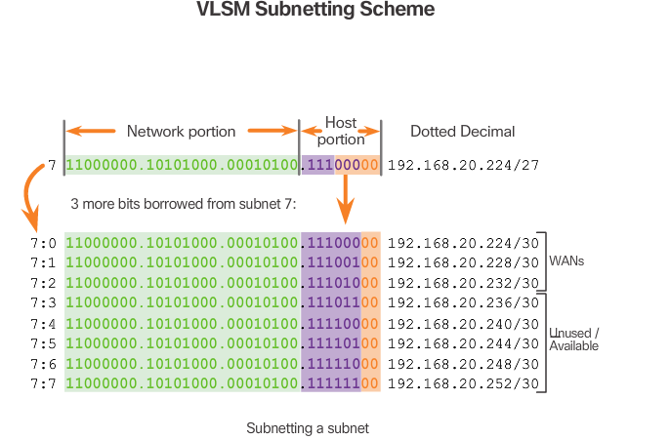
Basic VLSM
Notes:
8.1.5.3 Basic VLSM
8.1.5.4 Video Demonstration – Basic VLSM

Slide 3
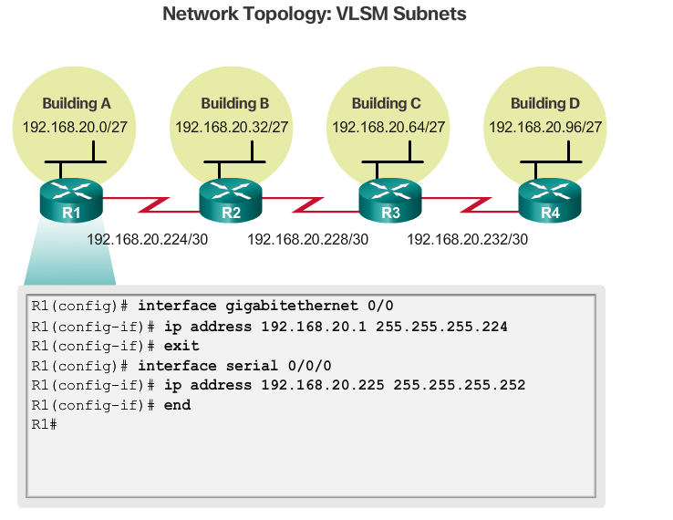
VLSM in Practice
Notes:
8.1.5.5 VLSM in Practice

Slide 4
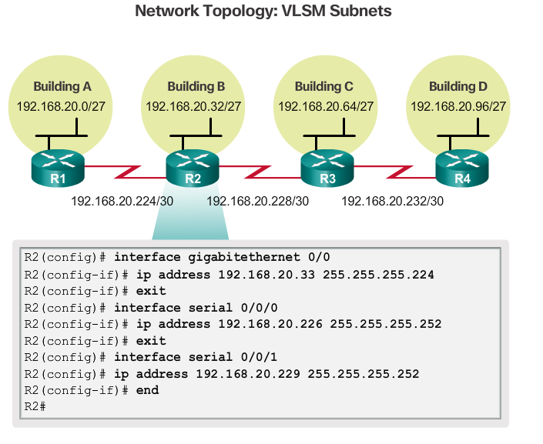
VLSM in Practice (cont.)
Notes:
8.1.5.5 VLSM in Practice (Cont.)

Slide 5

VLSM in Practice (cont.)
Notes:
8.1.5.5 VLSM in Practice (Cont.)

Slide 6
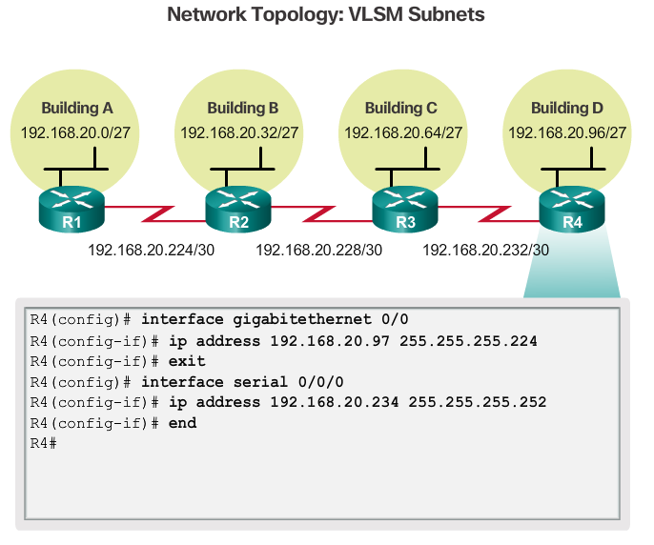
VLSM in Practice (Cont.)
Notes:
8.1.5.5 VLSM in Practice (Cont.)

Slide 7
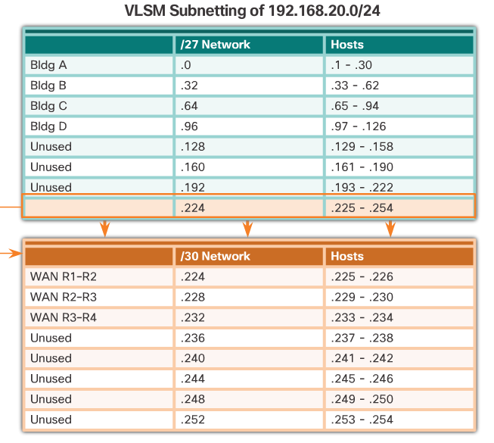
VLSM Chart
Notes:
8.1.5.6 VLSM Chart
8.1.5.7 Video Demonstration – VLSM Example
8.1.5.8 Activity – Practicing VLSM

Slide 8
Section 8.2: Addressing Schemes
Upon completion of this section, you should be able to:
Implement a VLSM addressing scheme.

Slide 9
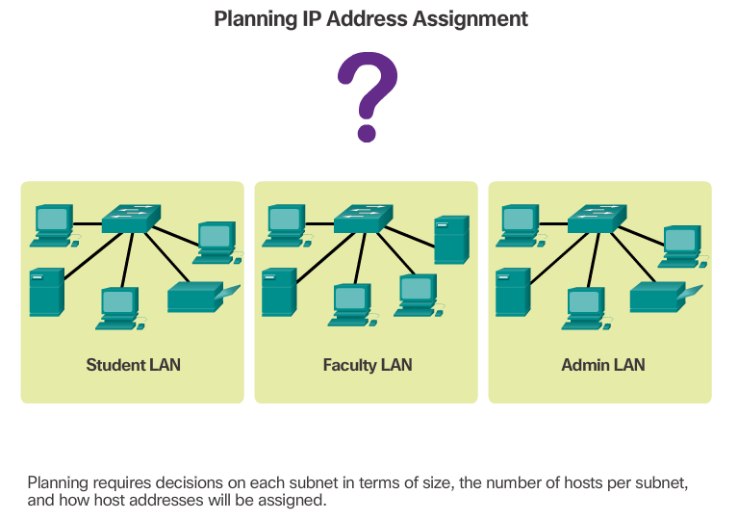
Network Address Planning
Notes:
8.2.1.1 Network Address Planning

Slide 10
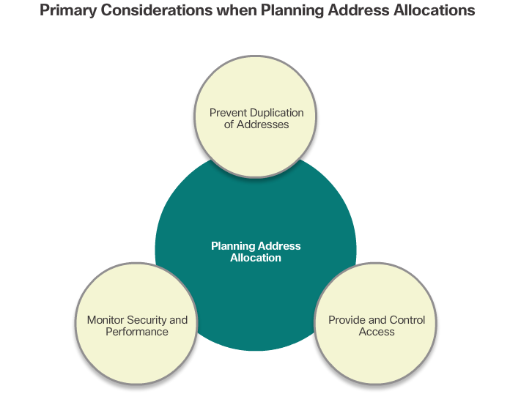
Planning to Address the Network
Notes:
8.2.1.2 Planning to Address the Network

Slide 11
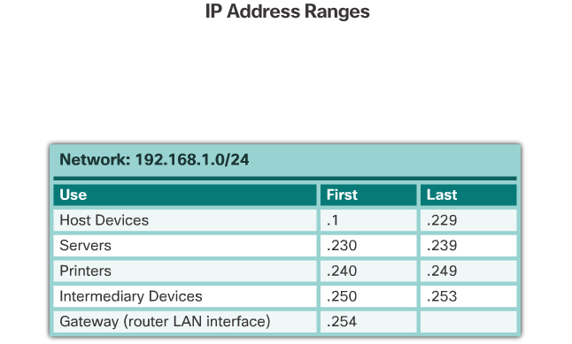
Assigning Addresses to Devices
Notes:
8.2.1.3 Assigning Addresses to Devices
8.2.1.4 Packet Tracer – Designing and Implementing a VLSM Addressing Scheme
8.2.1.5 Lab – Designing and Implementing a VLSM Addressing Scheme

Slide 12
Section 8.3: Design Considerations for IPv6
Upon completion of this section, you should be able to:
Explain how to implement IPv6 address assignments in a business network.

Slide 13
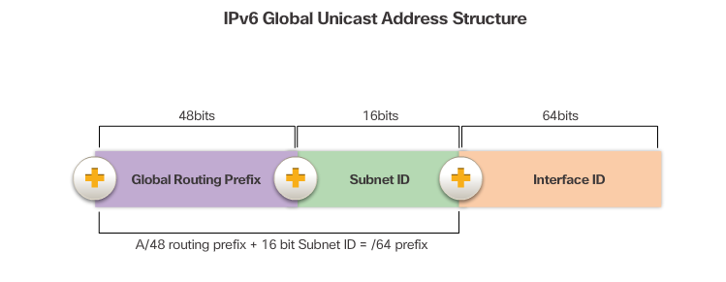
The IPv6 Global Unicast Address
The IPv6 global unicast address normally consists of a /48 global routing prefix, a 16 bit subnet ID, and a 64 bit interface ID.
Notes:
8.3.1.1 The IPv6 Global Unicast Address

Slide 14
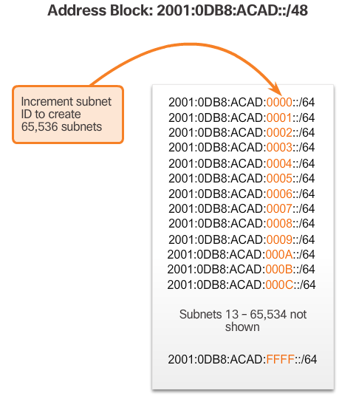
Subnetting Using the Subnet ID
Notes:
8.3.1.2 Subnetting Using the Subnet ID

Slide 15
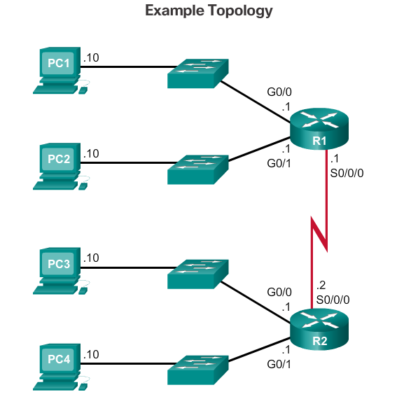
IPv6 Subnet Allocation
Notes:
8.3.1.3 IPv6 Subnet Allocation

Slide 16
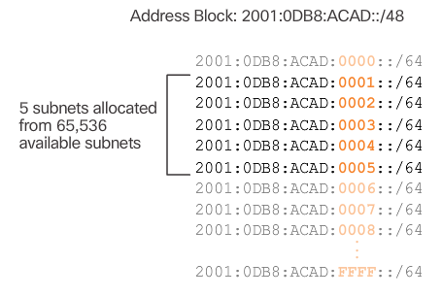
IPv6 Subnet Allocation (cont.)
Notes:
8.3.1.3 IPv6 Subnet Allocation (Cont.)

Slide 17
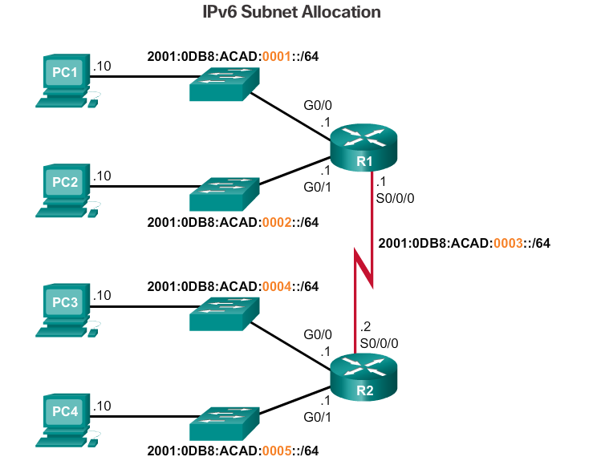
IPv6 Subnet Allocation (cont.)
Notes:
8.3.1.3 IPv6 Subnet Allocation (Cont.)

Slide 18
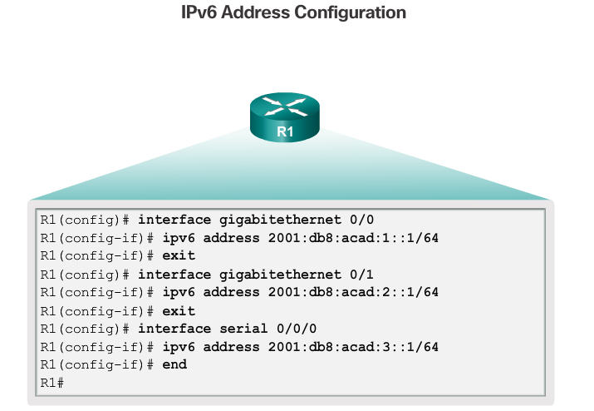
IPv6 Subnet Allocation (cont.)
Notes:
8.3.1.3 IPv6 Subnet Allocation (Cont.)
8.3.1.4 Packet Tracer – Implementing a Subnetted IPv6 Addressing Scheme

Slide 19
Section 8.4: Summary
Chapter Objectives:
Implement an IPv4 addressing scheme to enable end-to-end connectivity in a small to medium-sized business network.
Given a set of requirements, implement a VLSM addressing scheme to provide connectivity to end users in a small to medium-sized network.
Explain design considerations for implementing IPv6 in a business network.
Notes:
8.4.1.1 Class Activity – Can you call me now?
8.4.1.2 Packet Tracer – Skills Integration Challenge
8.4.1.3 Chapter 8: Subnetting IP Networks

